Slide 1
Unicorn Companies Analysis Presentation

Slide 2
Project analysis slide 2
TABLE OF CONTENT
SETTING THE CONTEXT
DATA CLEANING AND PREPROCESSING
PROJECT
METHODOLOGY
DATA ANALYSIS AND RESULT
DATA DICTIONARY
CONCLUSION

Slide 3
Project analysis slide 3
SETTIGN THE CONTEXT
OBJECTIVE: This project aims to gain insights into the startup industry by analyzing the time it takes for startups to become unicorns, identifying investors and companies that have produced the most unicorns, and providing actionable recommendations to industry stakeholders.
BACKGROUND: The project analyzes a dataset with information on over 1,000 unicorn companies globally to gain a better understanding of their success factors and characteristics that distinguish them from other businesses, including data on 1,250 investors.
The term "unicorn" refers to a private company with a valuation exceeding $1 billion and not listed on any stock exchange.
DATA SOURCE: The source of our project's dataset is from Kaggle, a platform for data science enthusiasts. The dataset includes information on unicorn companies and is publicly available at the following link: https://www.kaggle.com/datasets/deepcontractor/unicorn-companies-dataset

Slide 4
Project analysis slide 3
METHODOLOGY
The project will use a range of software tools to support the analysis, including Tableau, Python, R, and MS Excel.
Tableau is a data visualization tool that will be used primarily to create charts and graphs that make it easy to understand the data.
Python is a programming language that will be used to create network graphs, which can help identify patterns in the data that may not be easily visible with other methods.
R and MS Excel will be used for data cleaning and working with variables. This involves cleaning the data, removing any errors or inconsistencies, and transforming it into a format that is easier to work with.

Slide 5
Project analysis slide 5
DATA DICTIONARY
Field | Description | Data Type
Company | Name of the company | String
Valuation | Company valuation in Billions (B) of dollars | Integer
Year Joined | The year in which the company reached $1 billion in valuation | Date
Industry | Industry/Sector in which company is established | String
City | City the company was founded in | String
Country | Country the company was founded in | String
Continent | Continent the company was founded in | String
Year Founded | Year the company was founded | Date
Funding | Total amount raised across all funding rounds in Billions (B) or Millions (M) of dollars | Integer
Select Investors | Top 4 investing firms or individual investors (some have less than 4) | String
Investor Count | Number of Investor the company/startup has | Integer
Valuation to Funding Ratio | Ratio of Valuation divided by Funding | Float

Slide 6
Project analysis slide 3
DATA CLEANING AND
PREPROCESSING
Two new columns, 'Investor Count' and 'Valuation by Funding Ratio' were created for interesting visualizations in Tableau.
Null values in the 'funding' and 'investor count' columns were identified using R.
The dollar sign was removed from the 'Valuation' and 'Funding' columns to enable numerical calculations.
The 'Date Joined' and 'Year Founded' columns were converted to year-only format to support visualization efforts.
Select Investors were separated into different Investor Columns, each separated by a comma.

Slide 7
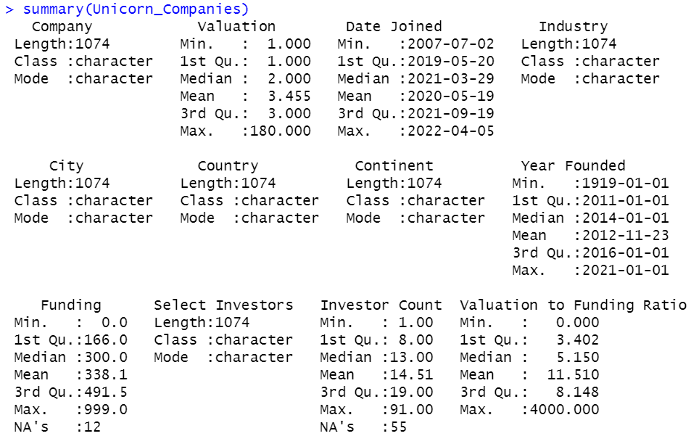
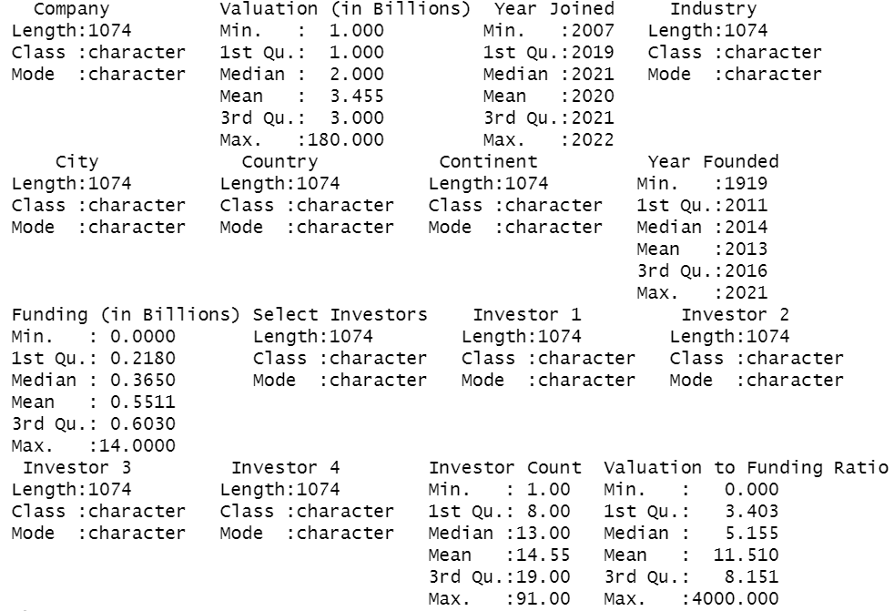
Project analysis slide 6
DATA CLEANING AND
PREPROCESSING
BEFORE DATA CLEANING
AFTER DATA CLEANING

Slide 8
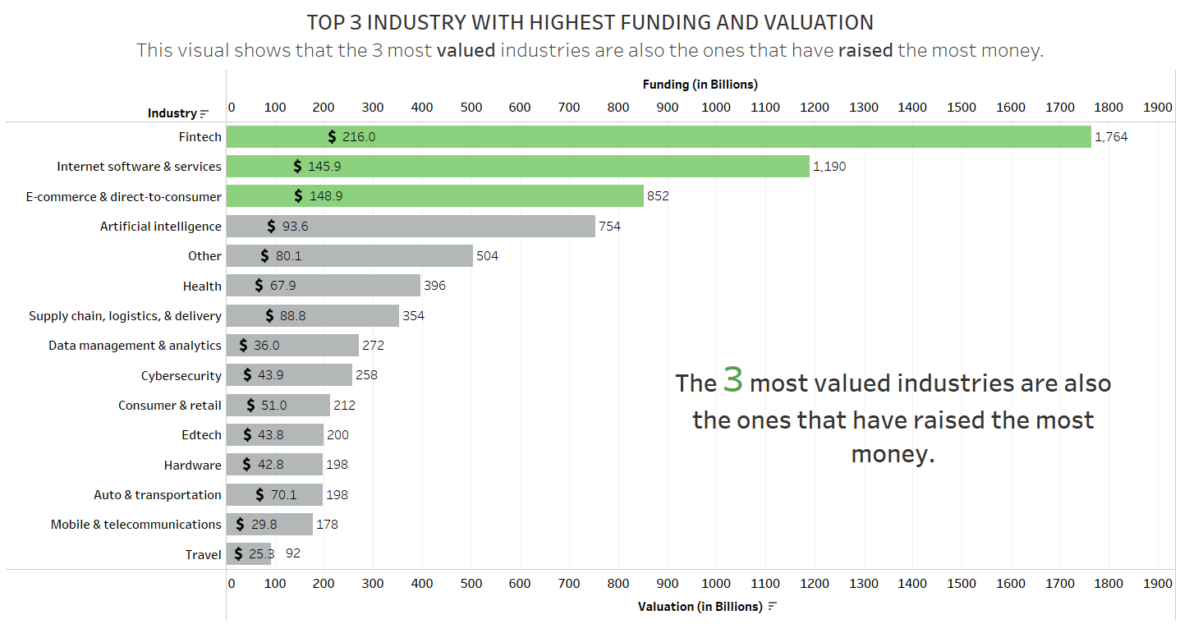
Project analysis slide 3
DATA ANALYSIS

Slide 9
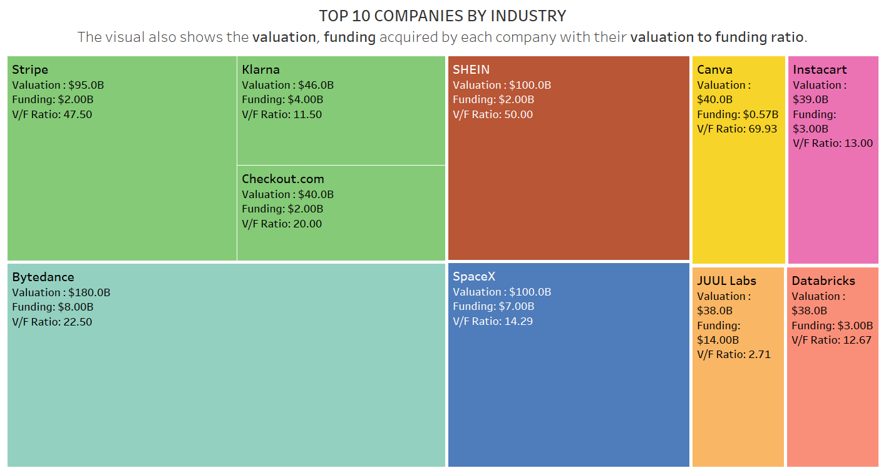
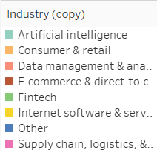
Project analysis slide 3
DATA ANALYSIS
Fintech
E-Commerce
Internet
Supply Chain
Artificial Intelligence
Other
Cons.
&
Retail
Data

Slide 10
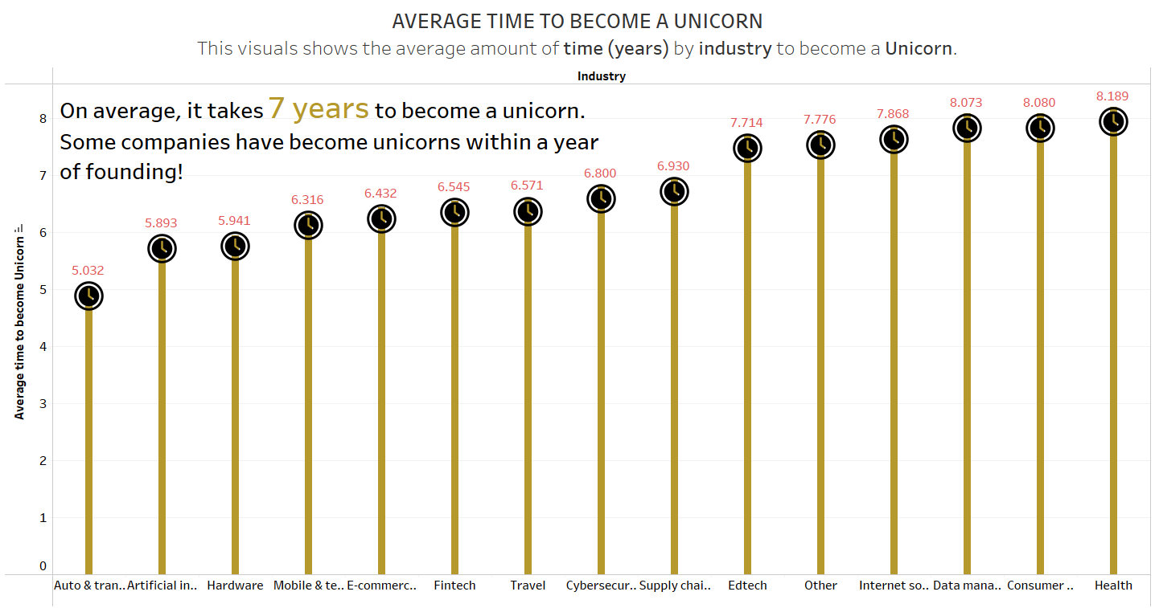
Project analysis slide 3
DATA ANALYSIS

Slide 11
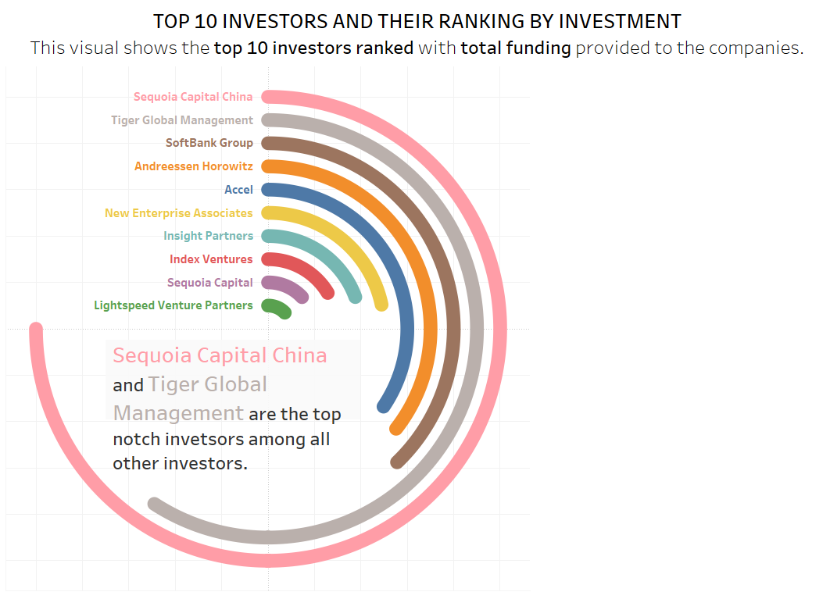
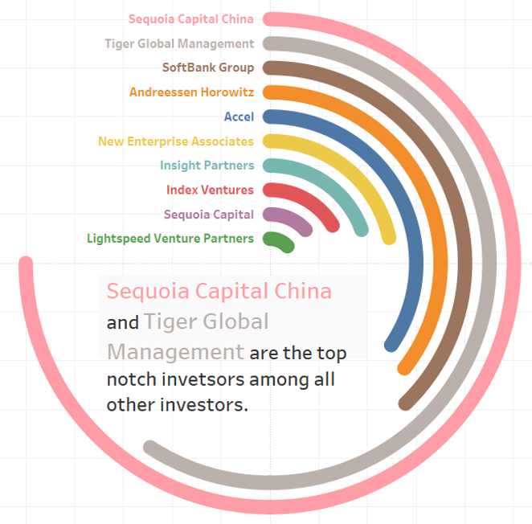
Project analysis slide 3
DATA ANALYSIS

Slide 12
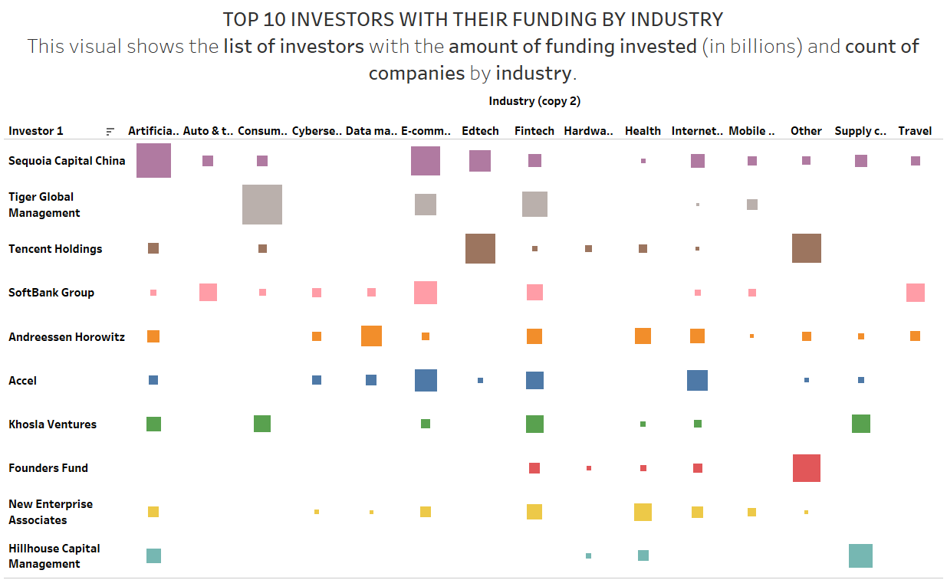
Project analysis slide 3
DATA ANALYSIS

Slide 13
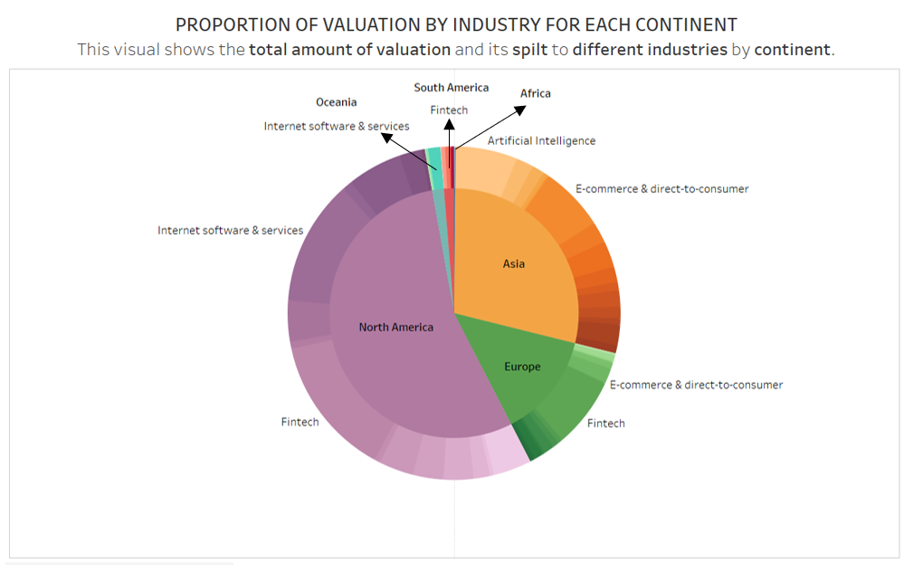
Project analysis slide 3
DATA ANALYSIS

Slide 14
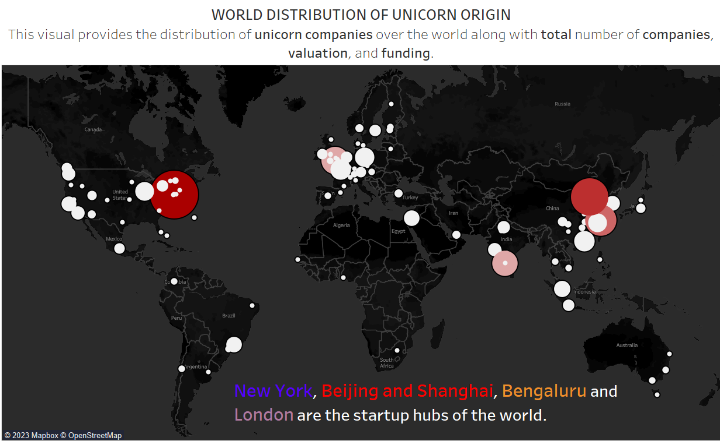
Project analysis slide 3
DATA ANALYSIS

Slide 15
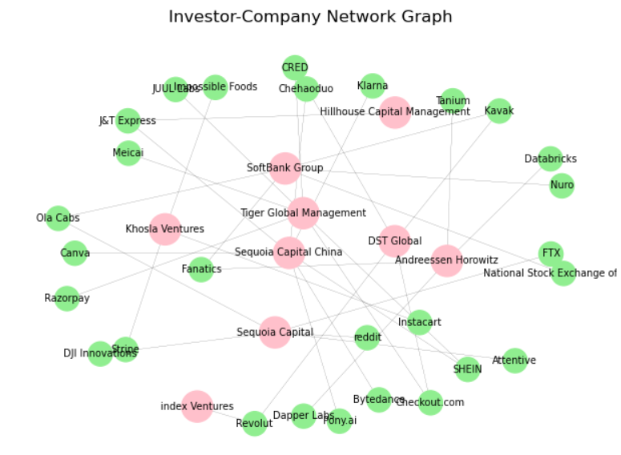
Project analysis slide 3
DATA ANALYSIS

Slide 16
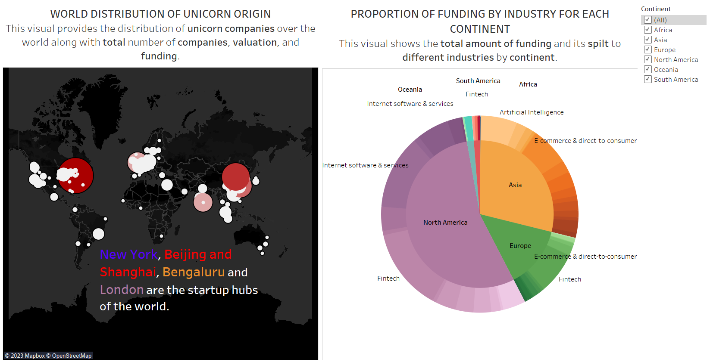
Project analysis slide 7
DASHBOARD - 1

Slide 17
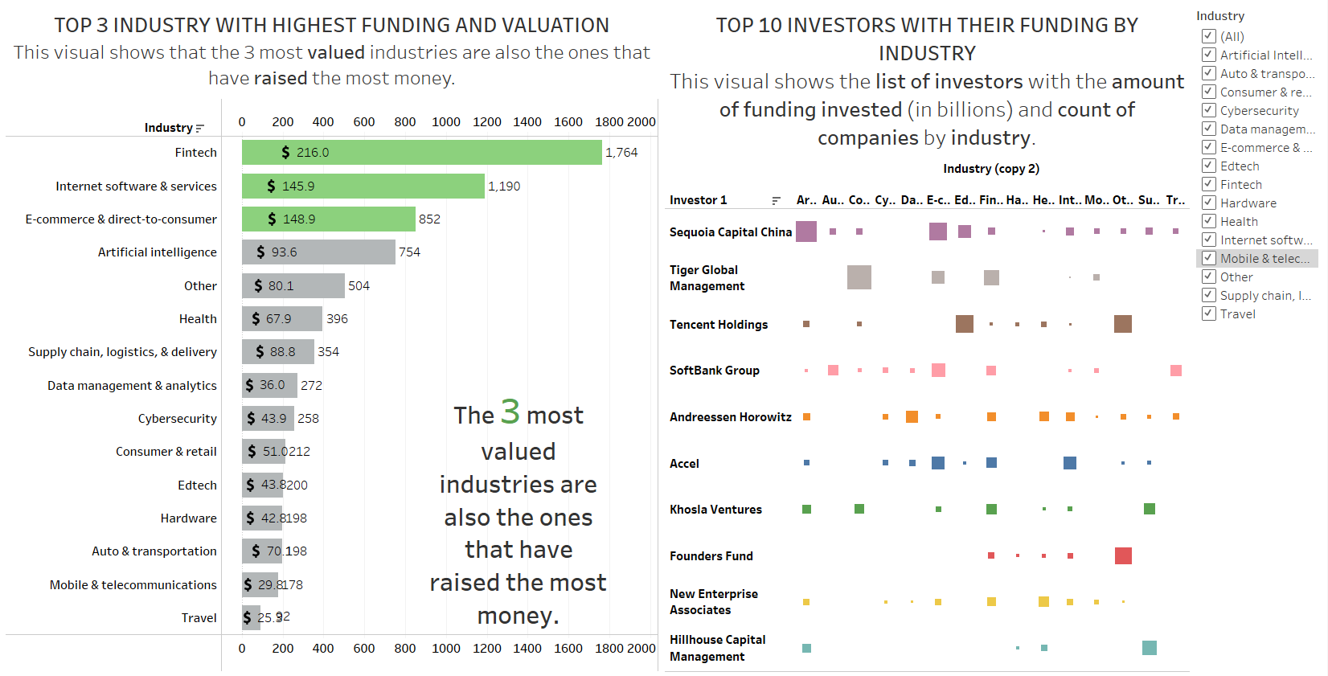
Project analysis slide 7
DASHBOARD - 2

Slide 18
Project analysis slide 8
CONCLUSION
The analysis has revealed that Fintech, Internet Software and Services, and E-commerce & Direct-to-Consumer industries have raised the most funding and achieved the highest valuations.
We also identified the leading companies in each industry, such as Stripe, Klarna, and Checkout.com in Fintech, Shein in E-commerce, and Canva in Internet Software and Services.
Additionally, we explored the average time it takes for companies to reach unicorn status in different industries and the top investors providing funding to these companies.
We highlighted the dominant players in the startup landscape across various industries.

Slide 19
Project analysis slide 8
CONCLUSION
We found that top investors primarily focus on technology-driven industries such as Fintech, E-commerce & direct-to-consumer, Artificial Intelligence, and Internet Software & Services.
We highlighted the dominance of North America, Asia, and Europe in terms of the number of unicorn companies and their valuation.
We showcased the startup hubs of the world, with New York, Beijing, Shanghai, London, and Bengaluru having the highest number of unicorn companies.
We also provided insights into the top investors and the companies they have invested in, which can aid entrepreneurs in securing funding for their own startups.

Slide 20
Thank You
Presentation By: Prince Kheni & Vrushal Mantri

